Slide 1
Lesson 3 Graphing Quadratic Functions by Factoring
i) Xavier Method – Finding roots by factoring, vertex and axis of symmetry by average of roots
ii) Domain and Range of QF
iii) Quadratic Formula
iv) Discriminant and the number of roots
© Copyright all rights reserved to Homework depot: www.BCMath.ca

Slide 2
Review: Linear and Quadratic Functions
Linear Functions
Straight Lines
General Form:
Highest degree for “x” is one
Quadratic Functions
Curved
Shape of a “Parabola”
Highest Degree for “x” is two
General Form:
© Copyright all rights reserved to Homework depot: www.BCMath.ca

Slide 3
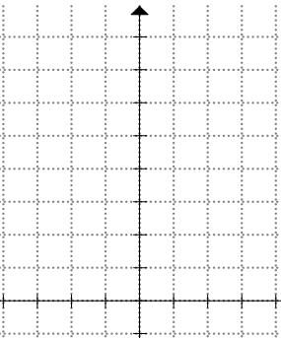
I) Why is a Quadratic Function U-shaped?
If we make a TOV, plot the coordinates, and connect the dots, the resulting shape is a Parabola
© Copyright all rights reserved to Homework depot: www.BCMath.ca

Slide 4
II) Components of a Parabola
Vertex: The coordinates at either the top or bottom of the parabola. Always in the middle
y
Axis of Symmetry: A line that cuts the graph in the middle. Must be an equation!
X intercepts: intersection point between parabola and the x axis: (x₁,0) and (x₂,0)
x
0
Y intercept: intersection point between parabola and the y axis: (0, y_{o})
Write both the X and Y intercept as coordinates
© Copyright all rights reserved to Homework depot: www.BCMath.ca

Slide 5
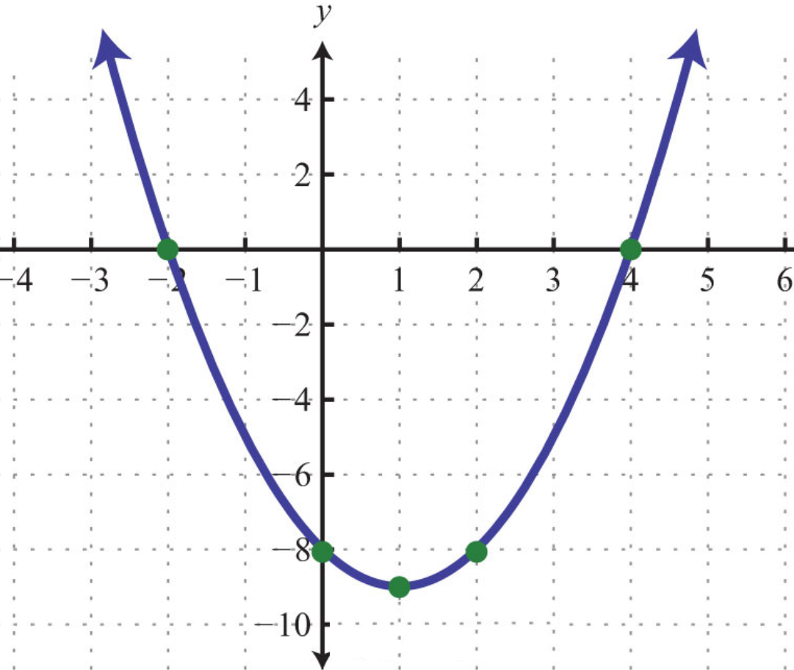
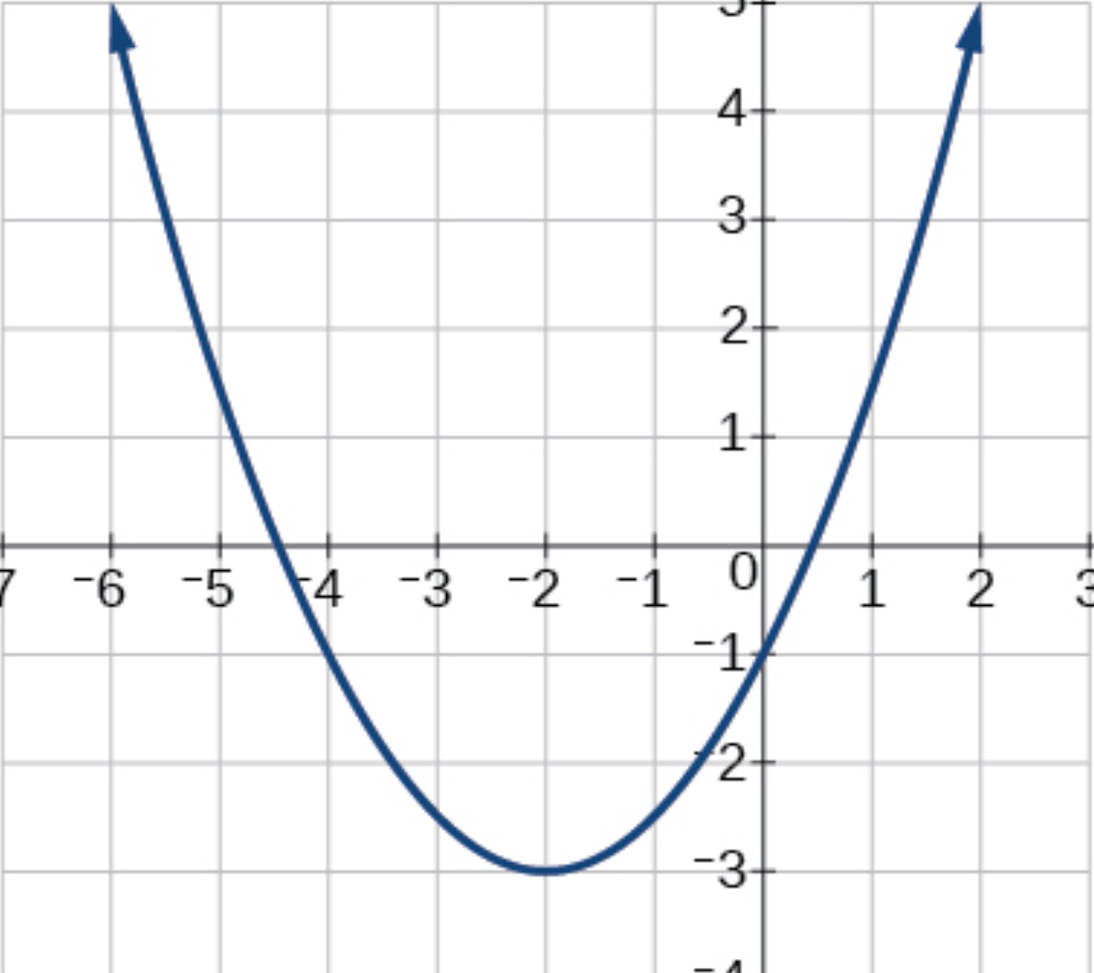
Ex: Given each parabola, indicate the i) coordinates of the vertex, ii) Equation of the Axis of symmetry, iii) X and Y-intercepts
Vertex:
Vertex:
Axis of Symmetry
Axis of Symmetry
X- intercepts
X- intercepts
Y- intercepts
Y- intercepts

Slide 6


Graphing Parabolas with Xavier’s Method
First find the vertex using X.A.V.
X: x-intercepts by factoring
A: Axis of Symmetry (average of x intercepts)
V: Vertex by substituting AOS into formula
Use the constant “a” to determine which way the graph opens (+’ve Opens Up) (–’ve Opens Down)
Plot a couple of extra points for a better graph
For Quadratic Functions that do not have x-intercepts, we will learn to graph them in the next section
y
y
x
4
-1
0
1
2
3
4
5
6
7
3
-1
2
-2
1
-3
-1
0
1
2
3
4
5
6
7
x
-4
© Copyright all rights reserved to Homework depot: www.BCMath.ca

Slide 7
Ex: Find the x intercepts, Axis of Symmetry, Vertex and Graph
1st Factor: X intercepts
At the x-intercept, the y-coordinate is zero
2nd Axis of Symmetry (Equation)
The A.O.S. is in the middle between the two x-intercepts!! (AVERAGE)
3rd Vertex: (Coordinates)
The A.O.S. and vertex has the same x-coordinate.
© Copyright all rights reserved to Homework depot: www.BCMath.ca

Slide 8
Graph:
1. X Intercepts: (-2,0) & (3,0)
2. Vertex
3. Plot several more points to get an accurate graph
© Copyright all rights reserved to Homework depot: www.BCMath.ca

Slide 9
Practice: Find the x intercepts, Axis of Symmetry, Vertex and Graph
1st Factor: X intercepts
2nd A.O.S.
3rd Vertex
© Copyright all rights reserved to Homework depot: www.BCMath.ca

Slide 10
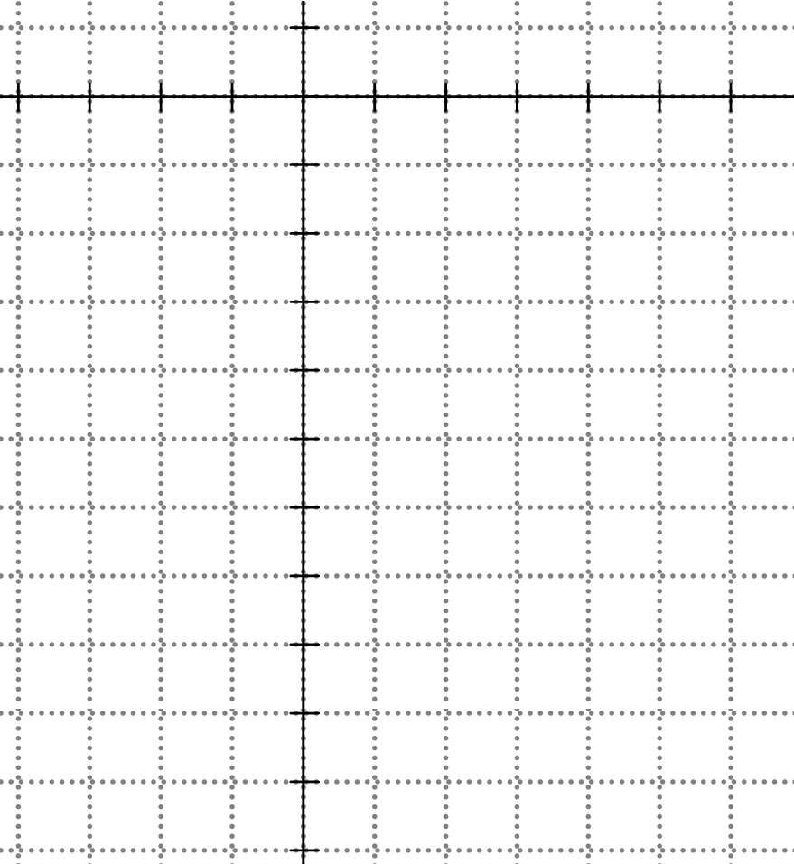
Graph:
1. X Intercepts: (-3,0) & (1.5,0)
2. Vertex
© Copyright all rights reserved to Homework depot: www.BCMath.ca

Slide 11
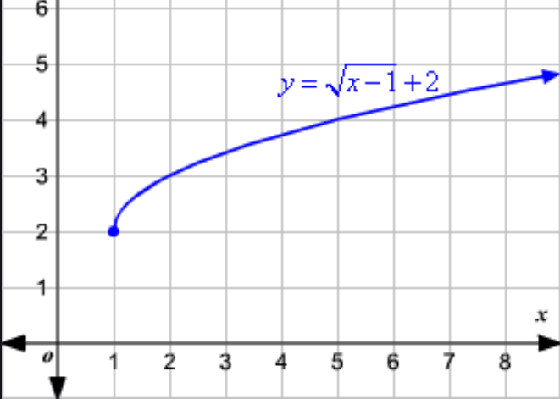
REVIEW: Domain and Range
The domain of a function is the collection of all the X-values that a function can have. Use a graph to find domain:
The range of a function is the collection of all the Y-values that a function can have. Use a graph to find range:
To find the domain, look at where the graph begins. This graph starts at x=1 and continues to the right
The find the range, find the lowest or highest point of the graph:
The lowest point of this graph is at y = 2, and then it goes up

Slide 12
Domain and Range of parabolas:
Since a parabola goes towards infinity to the left and right, it can take on any x-value
So the domain of a parabola is “All Real Numbers”
The range of a parabola depends on which way the graph opens and where it starts
If it opens up, range will be: y > lowest y- value
If it opens down, range will be: y < biggest y- value
y
10
The input number can be any value. The domain can be ‘All Real Number’
8
6
4
2
All output (y) values have to be greater or equal to two
x
-5
-4
-3
-2
-1
0
1
2
3
4
5
-2

Slide 13
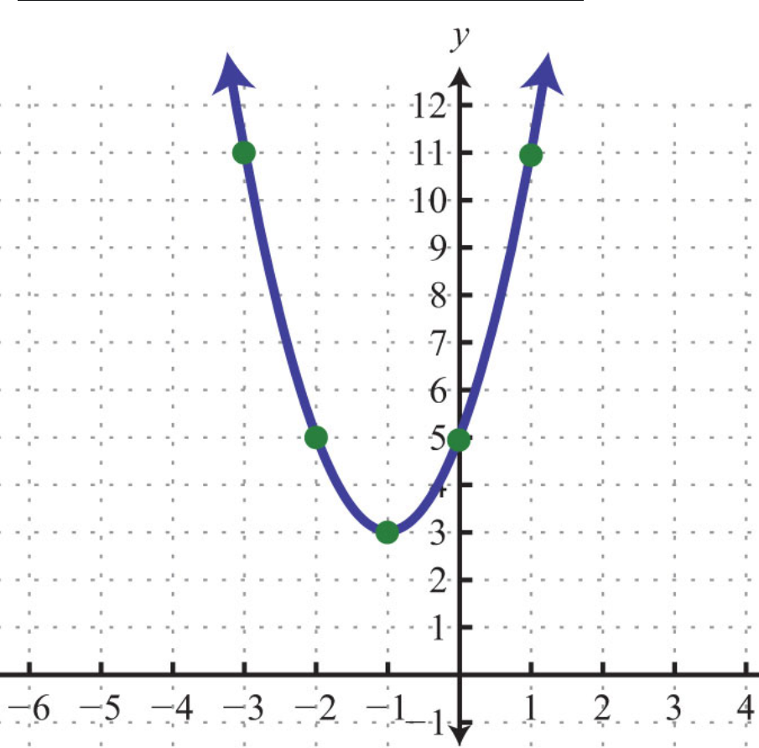
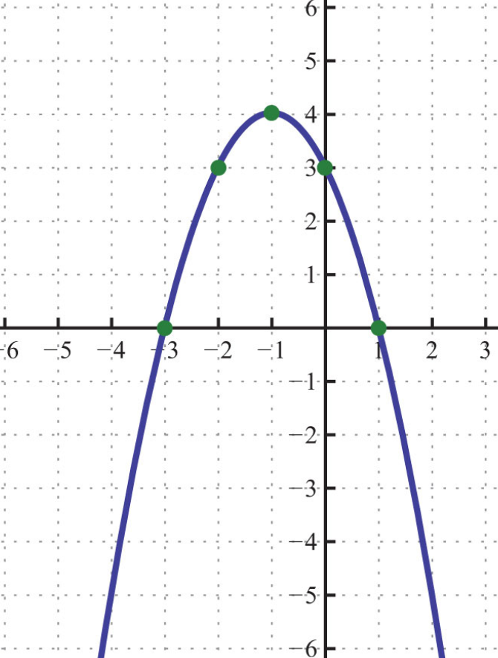
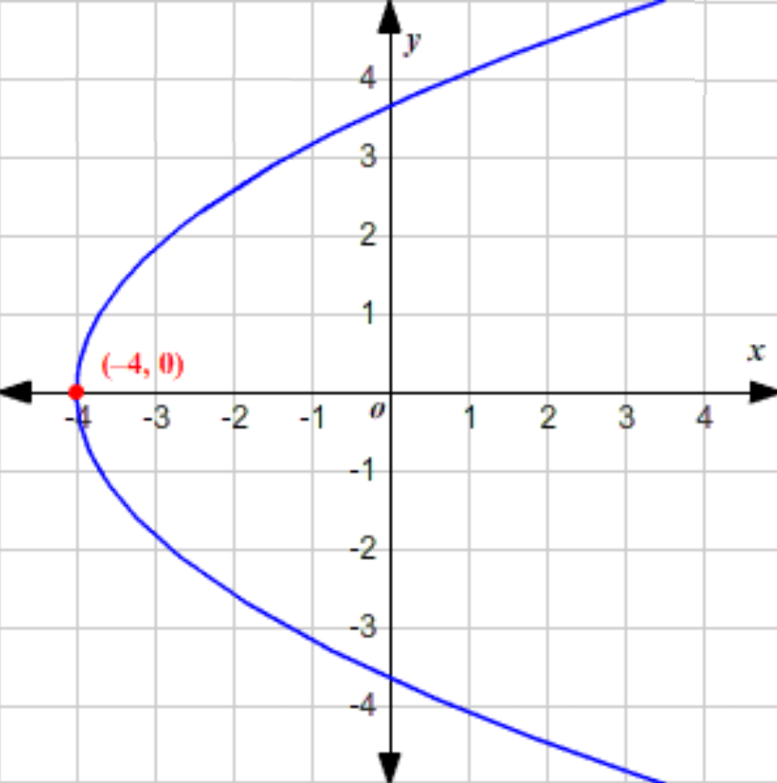
Ex: Indicate the domain and range for each of the following parabolas:
Domain:
Domain:
Domain:
Range:
Range:
Range:

Slide 14
Ex: Match each equation with the description that best describes it:
i) Range is y > – 4 , Axis of symmetry is x = 3
ii) X-intercepts at 2 and -2 Axis of symmetry is the Y-axis
iii) Range is y < 9, Axis of symmetry is x= – 1
iv) Graph opens down and vertex at (3,8)

Slide 15
Things to Remember:
The vertex is always in the middle between the two “X” intercepts
The Axis of Symmetry must always be an equation: x = k, where “k” is the x-coordinate of the vertex
The domain of a parabola that opens up or down will always be:
To find the Y-coordinate of the vertex, plug the x-value into the equation and solve for “y”
The vertex, x-intercepts, y-intercept should be provided as a pair of coordinates (a,b)
The y-coordinate of the Vertex will be used for the range of the function

Slide 16
What do you do if you can’t Factor the trinomial?
Answer: Use the Quadratic formula (next lesson)!
© Copyright all rights reserved to Homework depot: www.BCMath.ca

